Slide 1
Rails-06
3870

Slide 2
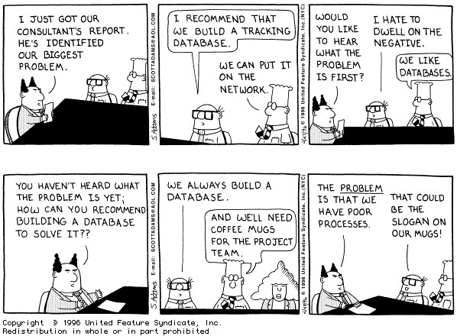

Slide 3
Webbrick hogs memory?
Don't you hate it when Webbrick shuts down automatically because you ran out of memory?

Slide 4
Use thin instead
# add the following gem to your Gemfile
gem 'thin'
# run bundle
bundle install
# run server as usual
rails server –b $IP –p $PORT

Slide 5
Messing up the project
You want to try out something in your project but you are afraid that you might mess it up…
What do you do?

Slide 6
Branch!
Git branch to the rescue:
git checkout –b trial
# after working furiously at it…
git add –A
git commit –m "my great update and it works!"
git checkout master
git merge trial
git branch –d trial

Slide 7
Gravatar
Do you have an image for your Github account?
Try the following in irb:
> require 'digest/md5'
> Digest::MD5.hexdigest("tacksoo.im@gmail.com")
I get "6c88d98683f5b0e747a7bfacfe80d979"
Try visiting:
http://gravatar.com/avatar/6c88d98683f5b0e747a7bfacfe80d979.png
Notes:
https://en.gravatar.com/site/implement/images/

Slide 8
Helpers!
module ApplicationHelper
def avatar_url(user)
gravatar_id = Digest::MD5.hexdigest(user.email.downcase)
"http://gravatar.com/avatar/#{gravatar_id}.png?s=48"
end
end

Slide 9
Exercise
Show user's gravatar image on nav bar using image_tag

Slide 10
Modifying a table with a new column
# this makes changes in the Videos table
rails g migration AddUserToVideo user:references
# don't forget to run your migrations
rake db:migrate

Slide 11
Add association
# this goes in the Video model
belongs_to :user
# this goes in the User model
has_many :videos

Slide 12
Update form
Remember where we create a new video?
Add the following so that a video is always associated with a user
user_id: session[:user_id]

Slide 13
Update form 2
def create
user = User.find_by(id: session[:user_id])
user.videos.create(params.require(:video).permit(:nick,:link,:comment))
end

Slide 14
Show items of a user
Now that each video is associated with one user, we can show all videos from a particular user
First let's add a route to it:
get 'user/videos' => 'videos#show_user_videos', as: :show_user_videos

Slide 15
Action to show all items
def show_user_videos
if session[:user_id]
@user_videos = User.find(session[:user_id]).videos
else
render new_session_path
end
end

Slide 16
Exercise
Code up "show_user_videos.html.erb" to display all Videos from the user

Slide 17
Access Problem
Right now, as it stands, any logged in user is able to edit videos.
How do we restrict this action?

Slide 18
before_filter to the rescue!
# in your controller, let's create correct_user method
before_filter :correct_user, only: [:edit]
private
def correct_user
@user = Video.find(params[:id]).user_id
flash[:notice] = "edit your own stuff man!"
redirect_to(root_url) unless @user == current_user
end

Slide 19
Exercise
Make sure the user is only able to edit things that it owns.

Slide 20
Presentation
10/20/30 rule (Guy Kawasaki)
10 slides
20 minutes
30 point (smallest font)
Notes:
From Guy Kawasaki: https://www.youtube.com/watch?v=-M13SObffog

Slide 21
Organization
Introduction
Related Works & Background
Motivation (what are we solving)
Demonstration
Credits
Q&A

